Slide 1
Microsoft Dynamics CRM 2011 Walkthrough
Part 2: Solution & system management
Jukka Niiranen
http://niiranen.eu/crm

Slide 2
Table of contents
Walkthrough Part 1
Walkthrough Part 2
End-user tools and UI enhancements
Outlook client
Form customization options
Auditing
Connections
SharePoint integration
Visualizations
Goals
Customization menus
UI customization options
Solution management
Web resources
Processes (workflows)
Custom activities
Queue enhancements
Multiple forms per entity
Security features
Cloud services
Upgrading from CRM 4.0
What’s not there in 2011

Slide 3
Customization Menus

Slide 4
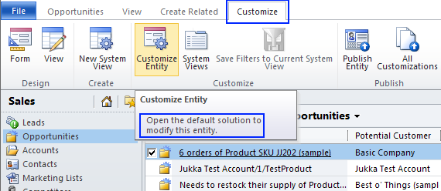
Ribbon access to Customizations
Administrators now have direct access to entity, form and view customizations from the main window or detail form of a record
Note: these shortcuts will always take you to the default solution, access to settings menu is needed for selecting which solution is to be customized

Slide 5
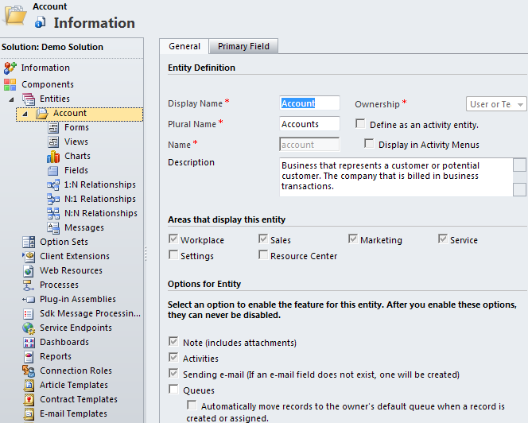
Hierarchical navigation
Solution components can be accessed from the hierarchical menu, thus reducing pop-up windows in the customization screen

Slide 6
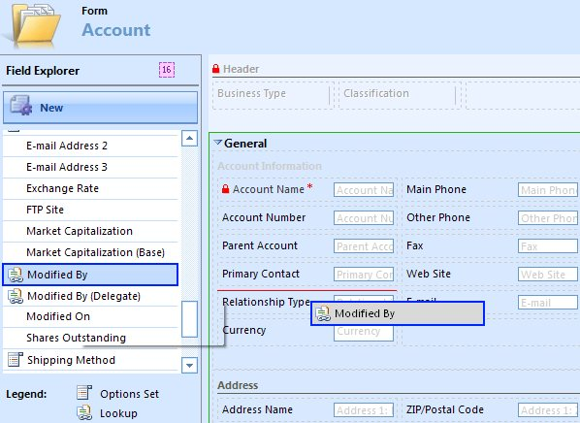
Drag & drop form editing
Field Explorer lists available fields and allows creation of new attributes
Arrange fields by dragging, remove by pressing Delete
Drag fields directly to the form

Slide 7
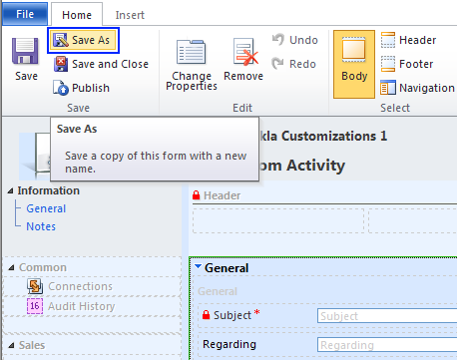
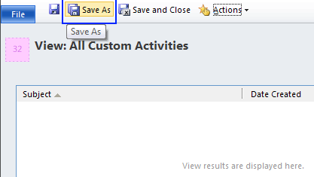
Save As -options
Available for views, forms, charts
Quick way to replicate existing configurations when adding new views and forms

Slide 8
UI customization options

Slide 9
Ribbon customization
Create custom sections and buttons to ribbons
Default ribbon elements can be hidden or overwritten with custom elements
No GUI editor, modifications done through XML:
Export the solution customizations
Edit the RibbonDiffXml
Create Web Resources for icons and scripts
Import solution
Outlook 2003 and 2007 will display ribbon elements as menus, Outlook 2010 has full ribbon

Slide 10
Ribbon features
Ribbon types available:
Entity ribbons: form, grid, subgrid
Web app specific: jewel (”File”), basic home tab
Others: dashboard, advanced find, form editor…
Ribbon element display & enable criteria:
Client type, field value, form state, record privilege, grid selection count, custom rules for Javascript libraries
Ribbon control actions:
Open a URL, pass parameters, call Javascript function
Ribbon element size and scaling priority order

Slide 11
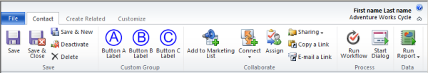
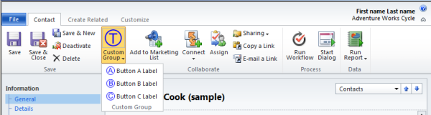
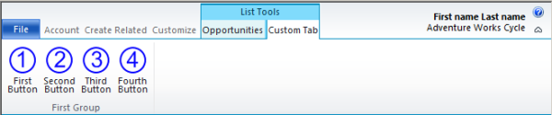
Examples of custom ribbon elements
Custom group and buttons in default layout
Custom group with popup button layout
Custom group in subgrid ribbon list tools
From Microsoft Dynamics CRM 2011 Beta SDK

Slide 12
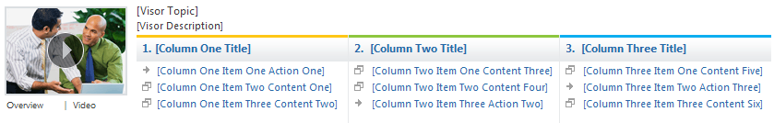
Getting Started Pane
Getting Started Pane is available for all entities that have viewable grirds in CRM UI
Allows presenting relevant instructions on the context of the entity being viewed
Supports HTML and Silverlight content
Users can show/hide the pane per entity or set global preferences through Options menu
SDK contains HelpVisorTemplate that can be used as a customization starting point for own panes

Slide 13

Performance with CSS sprites
CSS sprites reduce the HTTP calls to web server, thus improving performance in WAN environment
One image file is used to render several icons by showing only a specific region of the main sprite
Dynamics CRM 2011 utilizes sprites like ribbon.png to load and cahce all default icons
Note: Custom icons will have a higher payload and may affect page loading times

Slide 14
Solution Management

Slide 15
Not just customizations
In CRM 4.0, customizations and other configuration items were managed independently from one another
In CRM 2011, solutions are bundles of components that are used for delivering specific applications/functionalities
Each CRM organization has one default solution, in addition to which it can have multiple different solutions from different publishers

Slide 16
Solution components
Schema and metadata components
Entities, attributes, forms, views, charts, relationships, option sets
User interface components
Web resources, ribbons, sitemap, dashboards
Code components
Processes, dialogs, plug-ins, custom WF activities
Plug-in registration is also stored in the solution
System configuration components
Templates, security roles, reports, settings
Users and teams not included, roles need to be manually configured after solution installation

Slide 17
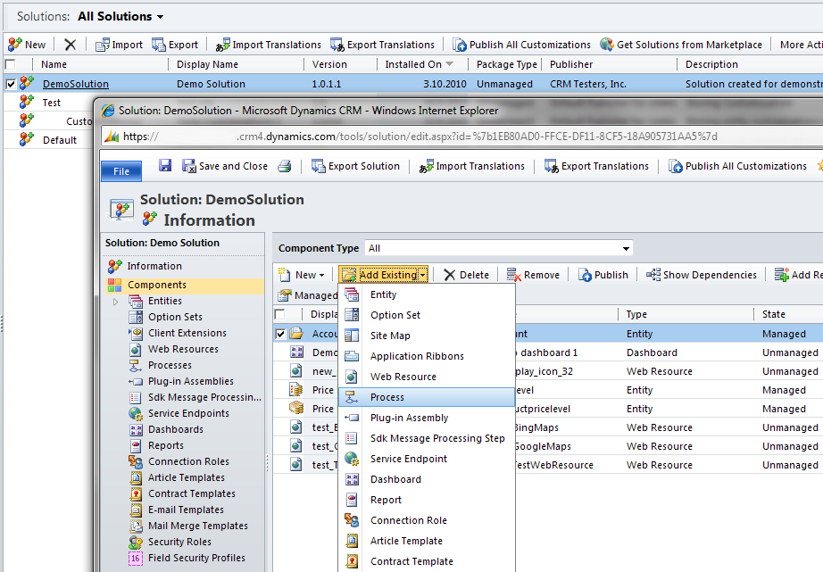
Customizing solutions in CRM
Add existing or new components to solution

Slide 18
Unmanaged / managed solutions
You can only create unmanaged solutions
Upon export you can choose to make the solution either unmanaged or managed
Managed solutions are locked from editing
Managed solutions each have their own “layer”, which will control adding and removing solutions to/from a system
Unmanaged solutions cannot be uninstalled
Only pointers to components, not separate containers
You can delete the solution, but components will not be deleted from the system

Slide 19
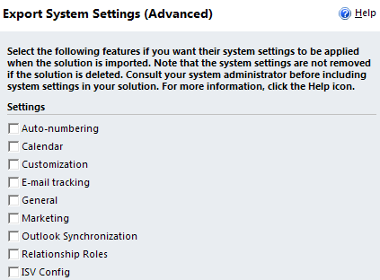
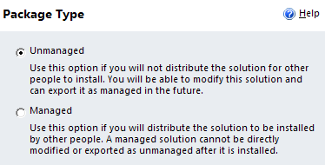
Exporting a solution
Including system settings in the solution
Export as unmanaged or managed solution

Slide 20
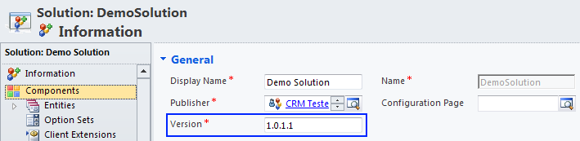
Updating solutions
Managed solutions in the system can be updated with new versions of the solution file provided by the publisher
No version control or rollback support in the CRM platform itself, needs to be managed by publisher
Solution version numbers are simply metadata set by the publisher

Slide 21
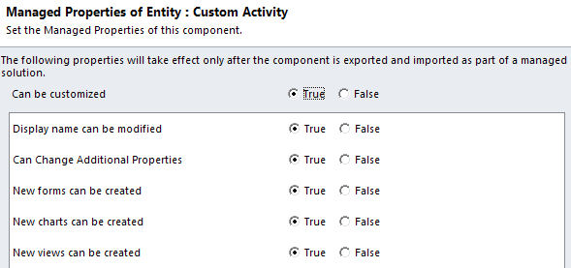
Managed properties
By default, all custom solution components are customizable
Managed properties can be enabled per component, which will enforce customization rights once the solution is exported as managed

Slide 22
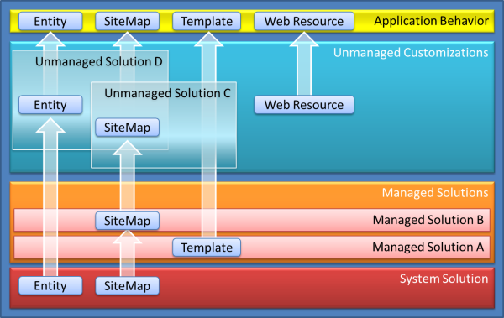
Solution layering
The active (default) solution is calculated from all the unmanaged and managed solutions applied to the system
From Microsoft Dynamics CRM 2011 Beta SDK

Slide 23
Merging solution contents
Solutions can and will very likely have dependencies to the same shared components
The order of solution installations is important: the last one wins
Conflicting form and SiteMap customizations can cause surprising results, which may require manual fixing after solution installation
Option sets have value prefixes to reduce the chances of conflicts between solutions
Ribbon customizations are defined by only stating the changed controls through RibbonDiffXml

Slide 24
Component export and import
Exporting a solution component from an organization will contain all the published changes, as there is only one active component in the system at any given time (and not different versions)
Upon importing solutions that update the same component, the changes are merged with the ones already published in the organization
Therefore, each distinct solution that is interacting with the same components should be developed inside a separate organization of its own
Organization
Component
Solution 1
Solution 2
Solution 3
Solution 1
Solution 2
Solution 3
Merge changes
Component
Organization

Slide 25
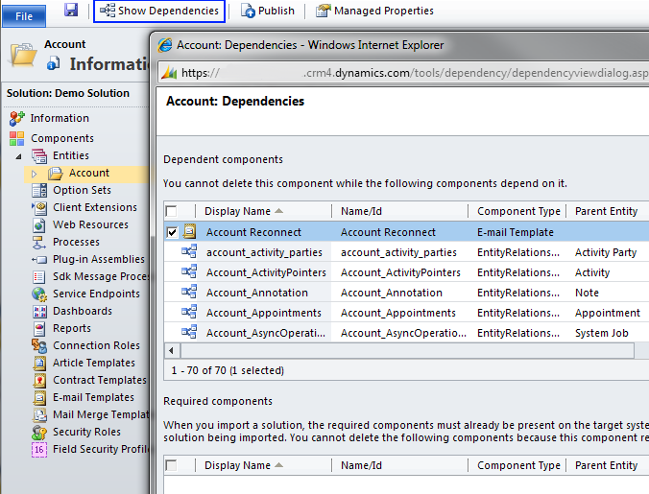
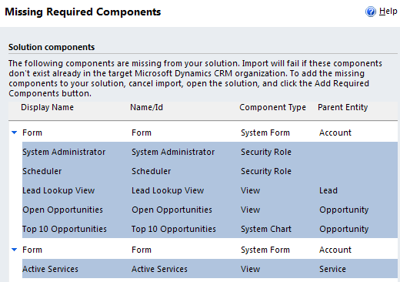
Dependency tracking
Show dependencies per component
Alerts upon solution export

Slide 26
Uninstall solutions
Uninstalling an unmanaged solution will leave all the components in the system, only the solution record is removed
Unmanaged solutions are simply component groupings
Uninstalling a managed solution will remove both components and data from the system
See post from David Yack: http://crm.davidyack.com/journal/2010/9/20/exploring-crm-2011-solution-framework-update-scenarios.html

Slide 27
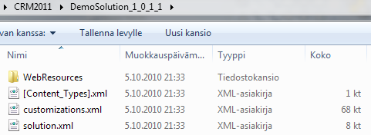
Solution files
ZIP files containing a set of XML files
No encryption, content can be browsed by the customer also in managed solutions
See blog post ”Inside the solution XML file” by Gayan Perera for more information:
http://weblogs.asp.net/gayanperera/archive/2010/09/14/peeking-into-the-dynamics-crm-2011-solution-export-file.aspx

Slide 28
Solution layering strategies
Evaluate the practical number of different solutions
More layers allow better modularity of solutions
…but can make development and layer management tricky, due to number of files and organizations
Separate CRM organization needed for publishing each individual solution layer
All exports are done from the unmanaged layer
Only import managed solutions to your test environment to preserve the default (unmanaged) layer
Automating build environments recommended to avoid mistakes of manual import process for multiple solution layers in multiple dev and test organizations

Slide 29
Team development strategies
When multiple developers are customizing a single environment, MS suggest the following strategies for manage team development:
Single organization, one master solution
Developers must work on separate components
Single organization, multiple developer solutions + one master solution
Each developer has an unmanaged solution + reference to master solution components, no need to merge changes
One organization per developer
Each developer has their own environment from which unmanaged solutions are imported into a master solution
From Microsoft Dynamics CRM 2011 Beta SDK

Slide 30
Web Resources

Slide 31
Contents and use cases
Web resources represent files that would have traditionally been placed on the CRM web server
Resource types supported:
Images: png, jpg, gif, ico
Website(app) components: html, css, javascript
Silverlight applications
Enables portability of custom pages and applications by packaging the resources into the solution file
Available also in Outlook client offline mode

Slide 32
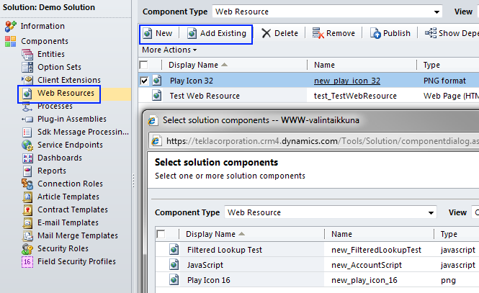
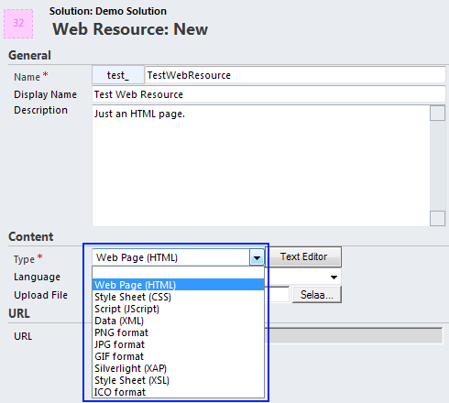
Adding web resources

Slide 33
Script libraries
Javascript libraries allow the central management and re-use of scripts across different entities and forms
Functions from the libraries can be associated with form and field events in form customization UI, while managing the code itself on the Web Resource hosting the library
See blog post by Ayaz Ahmad:
http://ayazahmad.wordpress.com/2010/09/25/javascript-libraries-in-microsoft-dynamics-crm-2011/

Slide 34
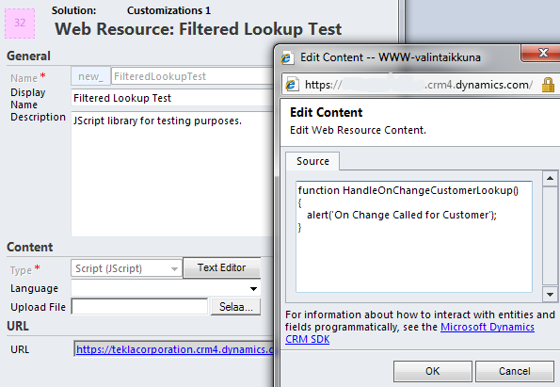
Using Jscript libraries (1)
Upload or cut&paste scripts into a new Web Resource

Slide 35
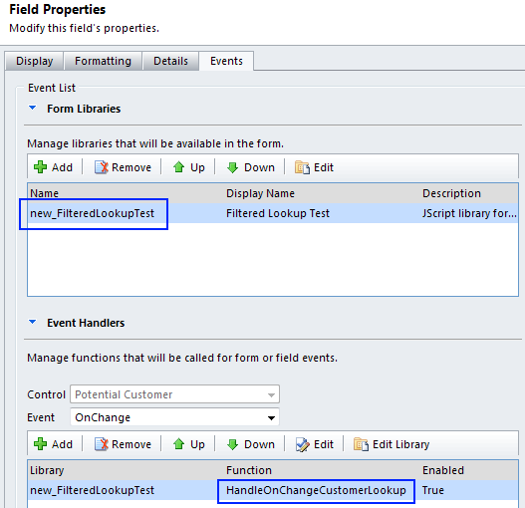
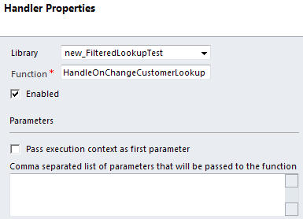
Using Jscript libraries (2)
In form or field properties, add reference to the web resource with the script library
Attach functions from the library to specific form or field events
Pass parameters to functions

Slide 36
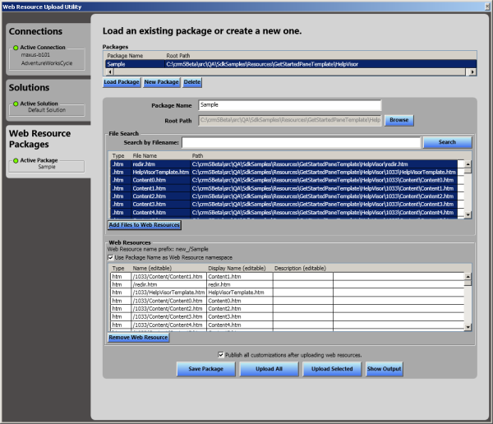
Managing web resources
CRM 2011 SDK contains a WPF tool called Web Resource Utility
Can be used for building Web Resource Packages to simplify management and uploading of individual files for CRM Web Resources

Slide 37
Processes (previously known as Workflows)

Slide 38
From workflows to processes
Workflow concept has been replaced with Process
Processes are split into 2 categories:
Workflows
Dialogs
Dialogs are basically interactive workflows that allow the user to enter input data while the workflow logic is being executed in the background
Whereas workflows can be started by a trigger and executed asynchronously, dialogs must be started by the user and executed synchronously
In short, dialogs are the ”wizard engine” for workflows

Slide 39
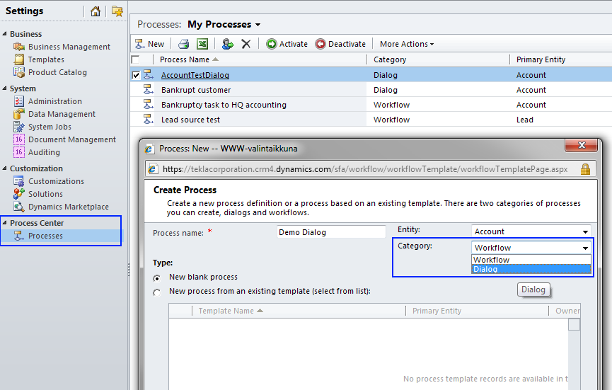
Process Center
Also the Process Designer UI is common to both Workflows and Dialogs
Dialogs and Workflows have similar presentation in the CRM UI under Process menus

Slide 40
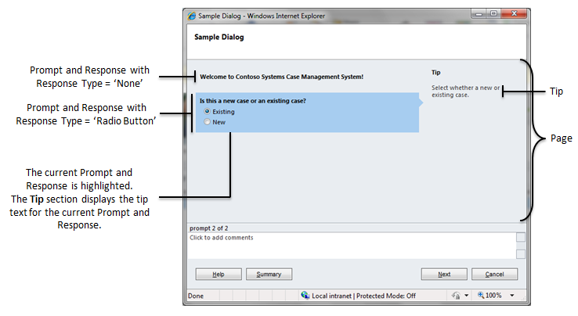
Dialog page components
From Microsoft Dynamics CRM 2011 Beta SDK

Slide 41
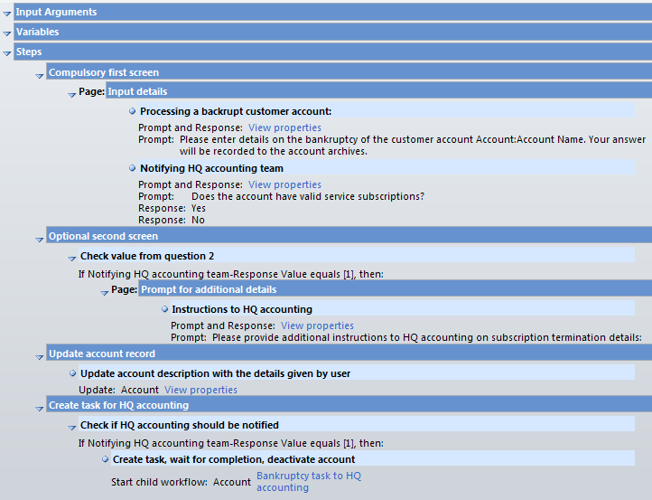
Dialog process conditions
Dialog page 1 with 2 input prompts
Dialog page 2 shown based on page 1 response
Continue the process asynchronously in a child workflow

Slide 42
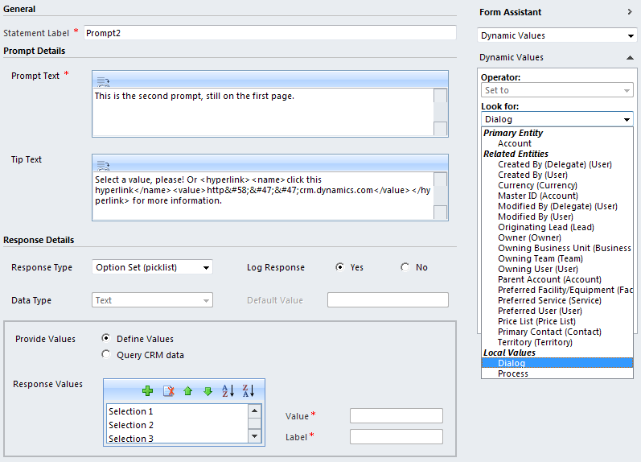
Dialog prompt options
Insert hyperlinks to instructions
Collect response data as picklist, nvarchar or ntext
Type in list of values or query CRM data
Insert dynamic values to text

Slide 43
Examples of Dialog use cases
Replace the built-in dialog windows such as ”convert lead” or ”close opportunity” with custom logic, also replace the ribbon buttons with references to custom Dialogs
Guide the user in new record creation process by showing instructions in prompts
Force the input of several required variables and descriptions when updating a field that is disabled on the entity form

Slide 44
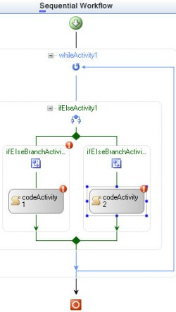
Processes for developers
.NET Framework 4.0 workflows
Create custom workflow activities
Fully declarative XAML modeling in WF 4 (workflows & activities)
Single XAML file
Modifications through Visual Studio 2010 Workflow Designer
Not supported for CRM Online

Slide 45
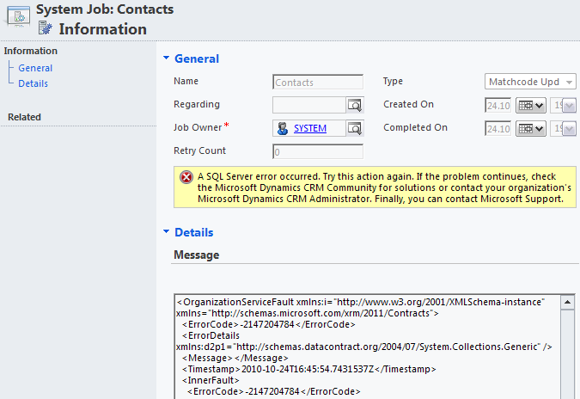
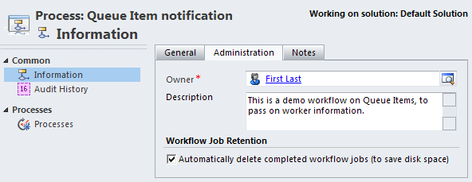
Process administration
System job error details visible in UI
Completed system job deletion can be set per workflow, to manage AsyncOperationBase table size

Slide 46
Upgrade from CRM 4.0
Running workflow instances will be upgraded to .NET 4 during server/organization upgrade
Custom workflow activities written for CRM 4.0 in .NET 3 are wrapped into .NET 4 interop activity

Slide 47
Notes on processes
Processes can be called through URL in a custom ribbon button
Combined with the new queues and custom activities in CRM 2011, processes and dialogs provide ”a better work management story” for visualizing business process automation in CRM UI

Slide 48
Dialog limitations
Dialog prompts do not support many native CRM form attribute types:
Bit, date, lookup…
Fields cannot be set as mandatory
Dialogs cannot be paused/resumed
Option sets cannot be queried in a Dialog
Custom UI’s cannot be embedded into Dialog pages (iframe/Silverlight/etc.)

Slide 49
Custom Activities

Slide 50
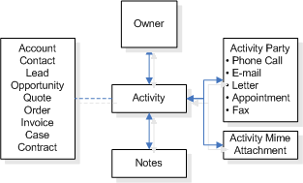
Features
Possible use cases:
Extending messaging types (IM, SMS etc.)
Work orders or other process specific activities
Support for all the different activity participant types available in out-of-the-box entity types
Customer, To, From, Cc, Required, Optional, Resource etc.
Display child record activities in account/opportunity roll-up views
From Microsoft Dynamics CRM 2011 Beta SDK

Slide 51
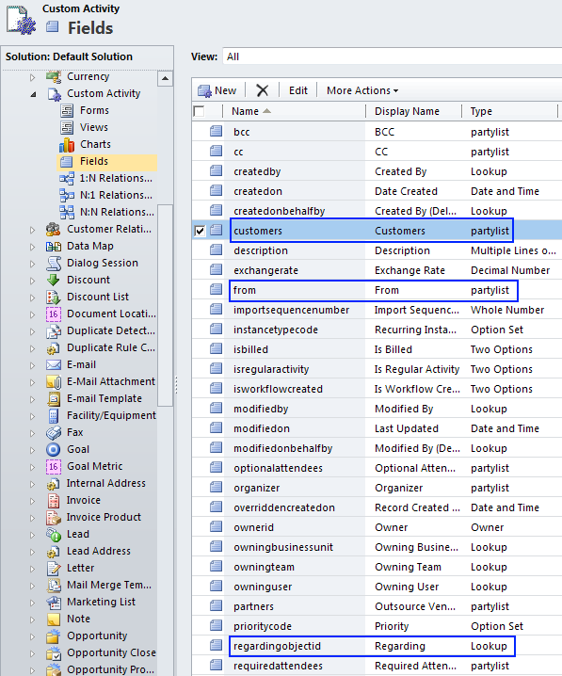
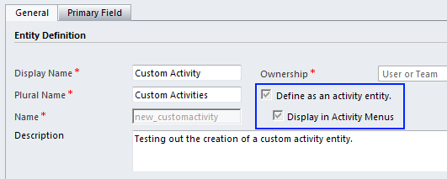
Creating a custom activity
Define entity type as activity upon creation and set visibility
Partylist attributes will be created for each custom entity by default

Slide 52
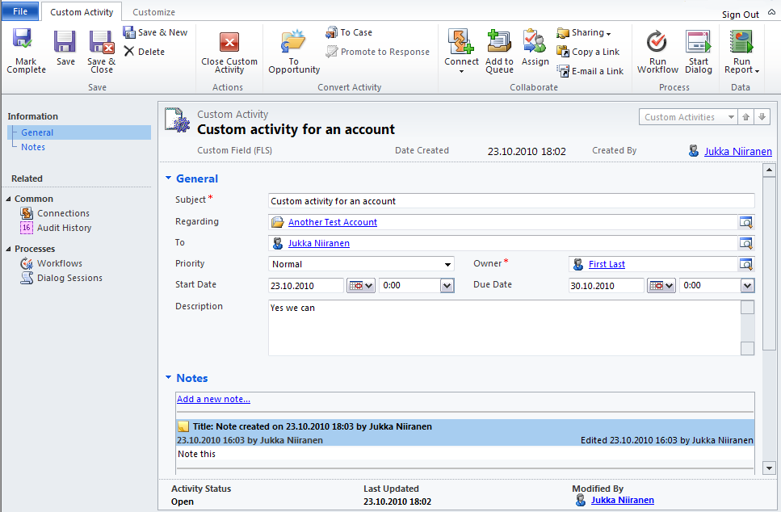
Example of a custom activity
Convert activity to other records
Send activity to queue
Manage activity parties

Slide 53
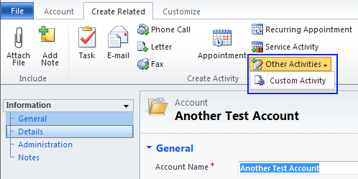
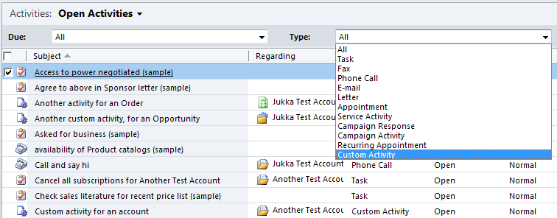
Managing custom activities
Create related activities
View open activities

Slide 54
Queue enhancements

Slide 55
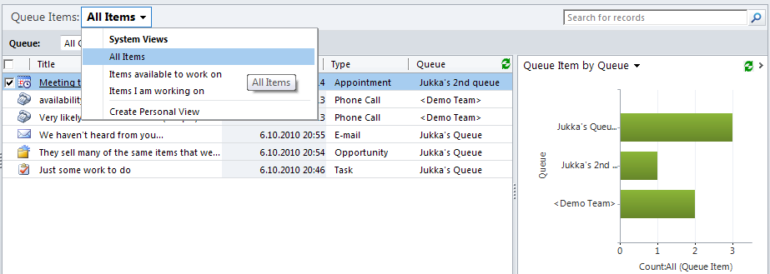
Queues in CRM 2011
All customizable entities can be enabled for queues
By default, queues are automatically generated for users, teams and business units
All of these can also be used for managing user rights

Slide 56
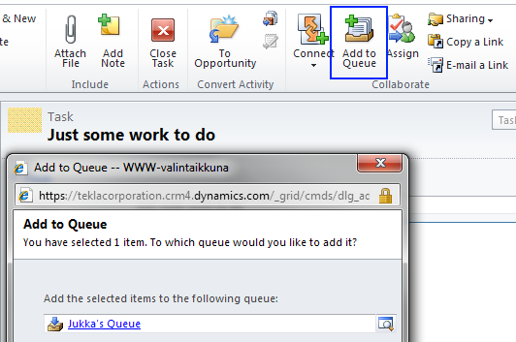
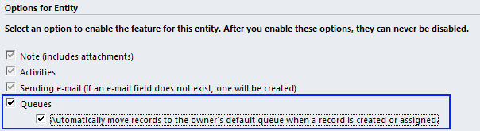
Adding record to queue
Manually add records to queue
Set all created & assigned records to appear in owner’s queue automatically

Slide 57
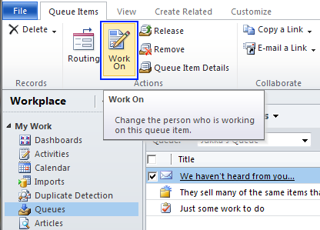
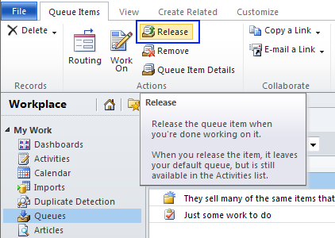
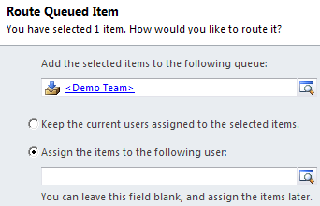
Actions on queue items
Declare who is working on the queue item
Release queue items without completing them

Slide 58
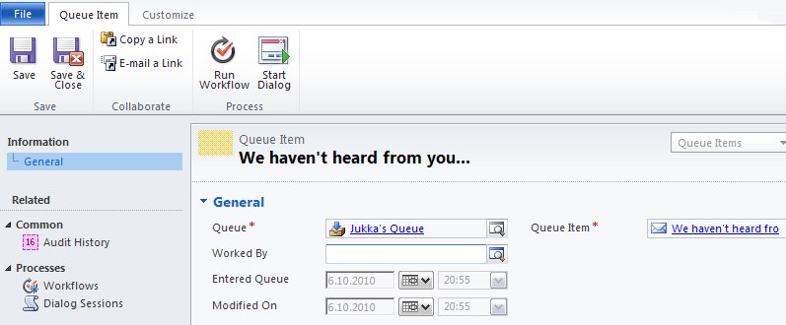
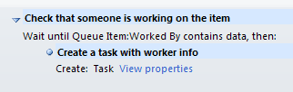
Queue item entity
Workflows can be triggered based on queue item creation / update

Slide 59
Multiple forms per entity

Slide 60
Role based forms
Entities can now have more than one form
Existing forms can be copied to create variations
The form presented to a user is determined by the security roles assigned to available forms
No support for ”rule based forms”, i.e. showing a form based on entity variable data
Show/hide scripts still needed to achieve the functionality

Slide 61
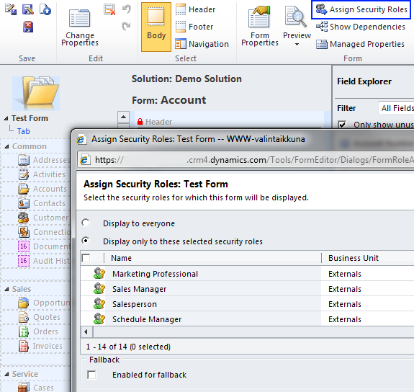
Managing form security roles
Determine security roles that are allowed to view the form
Set fallback form when no matching roles found

Slide 62
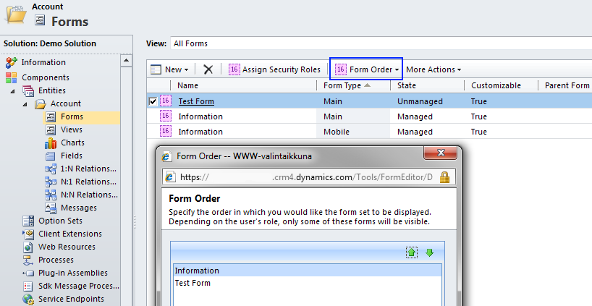
Managing form order
Define form display priority order when roles allow viewing multiple forms

Slide 63
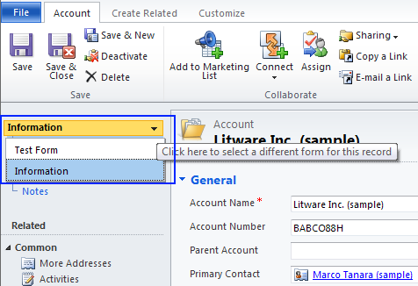
Form selector
When a user has the security roles that allow viewing more than one form, a form selector will be shown
Form can be changed with onLoad script
Note: will cause the form to load again (and the onLoad event…)

Slide 64
Security features

Slide 65
Field Level Security
In addition to entities and forms, data visibility in CRM 2011 can be controlled also per field
Applies to all components (reports, filtered views), data is never sent to client without access rights
Field Security is not available for standard fields, such as contact address & name

Slide 66
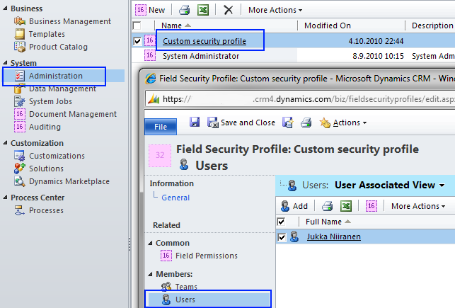
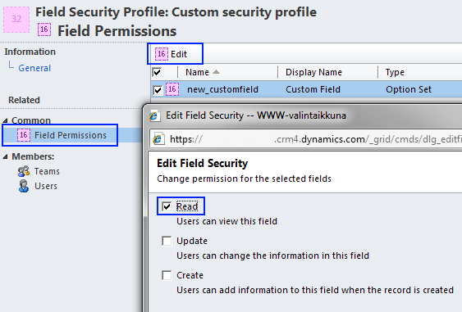

Enabling field security
Create a Field Security Profile and assign it to users or teams
Set access rights per profile
Enable Field Security in entity customizations

Slide 67

Team ownership
New features:
Assign security roles to an entire team
Teams can own records
There is a default team for each business unit. All users in a business unit are members of this team
Access checks are additive. You can access entities based on the roles assigned to the user plus the roles assigned to the team a user is a member of. This allows a user to have privileges outside their business unit
Teams can be deleted
From Microsoft Dynamics CRM 2011 Beta SDK

Slide 68



Assigning records to teams
Define team BU
Assign security roles and members to team
Assign team as record owner

Slide 69
CRM Online enhancements

Slide 70
Code on the server
Plug-in deployment to CRM Online allowed with isolated mode (sandbox)
Cannot access files, event log, network, etc.
Custom workflow activities are not supported
Plug-ins can consist of only a single assembly .dll
Plug-in statistics available for monitoring the behavior of individual plug-ins in a hosted environment
Execution count, failure count, crash count

Slide 71
Custom applications
Web Resources in solutions cannot execute code
No support for .aspx pages, MS suggested solution is to host these pages on Azure
Custom UI’s could be built with HTML/jQuery or Silverlight, to allow packaging and distribution inside the solution file

Slide 72
Custom reports
Custom SSRS reports can be uploaded to CRM Online
However, no direct access is allowed to database views = no SQL data sources can be used
FetchXML will be the primary method for building custom reports for CRM Online
Runtime component available for SSRS, Fetch Authoring Extension for VS
See post on MS CRM Team Blog for details:
http://blogs.msdn.com/b/crm/archive/2010/10/19/getting-started-with-custom-reports-in-the-cloud.aspx

Slide 73
Dynamics Marketplace

Slide 74
Marketplace features
Integrated into the Settings menu in CRM
Built on the existing Microsoft Pinpoint site
Listings for add-on applications, professional services, hosting services
CRM 2011 is not a requirement, thus available also for add-on applications that are not delivered as solution packages
Initially no eCommerce functionality available for purchase and payment transactions

Slide 75


Marketplace in CRM

Slide 76

Marketplace listing contents

Slide 77
Listing requirements
Two separate categories for applications:
Certified for Microsoft Dynamics (CfMD)
Community-rated solution
Requirements for certified applications
Application must pass the CfMD software tests
10 customer references
MS Gold Certified Partner status
Sure Step certification exam
Escrow service must be used for storing IP assets such as source code and documentation

Slide 78
Azure

Slide 79

AppFabric
Service Bus for messaging between applications
Bridges on-premises and cloud applications
Exposes applications through corporate firewalls
Access Control Service for authentication
Windows Identity Foundation (WIF) integration
Supports OAuth, OpenID, Windows Live ID, Google, Facebook…
On-premises requires purchase of a private certificate, Online certificate available from MS

Slide 80

Integration through Service Bus
CRM 2011 Online event execution pipeline has been exposed to AppFabric Service Bus
Allows posting data processed in CRM events to Service Bus through a CRM plug-in
Can be used for integration scenarios where CRM Online must exchange data with on-premises applications
From Microsoft Dynamics CRM 2011 Beta SDK

Slide 81
Upgrading

Slide 82
System requirements
Server
Only 64-bit SQL and IIS servers are supported
Windows Server 2008, SQL Server 2008
Exchange 2003, 2007, 2010, Online (optional)
SharePoint 2007, 2010 (optional)
Client
Office 2003 (SP3), 2007, 2010
Internet Explorer 7, 8 (Beta does not yet support IE9)
32-bit or 64-bit

Slide 83
Upgrade paths
Migration
Recommended option, allows import per organization
Old CRM4 instance can remain operational during upgrade
Separate SQL Server instances required
Connect to existing
Install new CRM server, upgrade existing SQL database
In-place
Most simple process, but old server environment must meet 2011 requirements
CRM 3.0 environments must first be upgraded to CRM 4.0 (can use trial version)

Slide 84
Client upgrade
CRM 4.0 Outlook clients (UR7+) are compatible with CRM 2011 server
CRM 2011 clients are NOT compatible with CRM 4.0 server
New client cannot be pre-deployed, client upgrades to be performed after server upgrade
CRM 4.0 Offline client changes can be updated to CRM 2011 server, but Go Offline is not available for CRM 4.0 clients after server upgrade

Slide 85

CRM 4.0 / 2011 customizations
You can’t directly import CRM 4.0 customizations into CRM 2011 system
However, you can import a CRM 4.0 organization through the Deployment Manager

Slide 86
Accelerators
New versions of the accelerators will be released, as stated by Microsoft
However, unlikely to be available at CRM 2011 RTM/RTW
Latest estimate: 6 months after CRM 2011 RTW
Upgrading an existing CRM 4.0 instance to CRM 2011 with the accelerator components installed may work, but there’s no guarantee on functionality

Slide 87
Virtual machines for CRM 2011
Everything is x64 now (IIS, SQL) = no more MS Virtual PC or MS Virtual Server images
Hyper-V is an option if you’re running Windows Server 2008 on your PC
If not, go for Oracle (Sun) VirtualBox
Creating a virtual machine with VirtualBox:
http://crmscape.blogspot.com/2010/09/creating-ms-crm-2011-vm-part-1-of-2.html

Slide 88
Code compatibility

Slide 89
Web service
CRM 4.0 web service endpoint (2007) is supported, CRM 3.0 (2006) is not available
Web service authentication throuhg WCF

Slide 90
Plug-ins
Sandbox (isolation mode) not available for CRM 4.0 plug-ins
CRM 3.0 plug-ins (callouts) are not supported

Slide 91

crmForm object is deprecated
Xrm.Page object is the new namespace
crmForm backward compatibility but with limited features
From Microsoft Dynamics CRM 2011 Beta SDK

Slide 92
Form scripts
Changes in the Client API scripting model and namespaces
Old: var AccName = crmForm.all.name.DataValue
New: var AccName = Xrm.Page.getAttribute(”name”).getValue()
Javascript converter for CRM 4.0 scripts: http://crm2011scriptconvert.codeplex.com/
During the upgrade from 4.0, old form scripts will be converted into .js Web Resources

Slide 93
ISV folder is deprecated
Calling the 2011 Web services from the <crmwebroot>\ISV folder is no longer supported
Custom ASPX pages in the ISV folder work after CRM 2011 if they meet the criteria listed in SDK

Slide 94


No more Dynamic Entity
Dynamic Entity has been replaced with the base class Entity
CRM 4.0
CRM 2011
From Microsoft Dynamics CRM 2011 Beta SDK

Slide 95
What’s not there

Slide 96
Search improvements
No Outlook / Windows Search type of “global search” functionality for searching across different entities
No “Google style” full text search for using multiple search terms in same search field
Indexing CRM data with SharePoint through BDC (2007) / BCS (2010) can be used to overcome the search functionality limitations

Slide 97


Activity streams
Microblogging á la Yammer or Salesforce.com Chatter is not a Dynamics CRM feature
SharePoint 2010 activity streams are the closest match in Microsoft’s portfolio, integration with CRM data and events could possibly bring more “Enterprise 2.0” flavor to Dynamics CRM in collaborative usage scenarios
Example of microblogging add-on for Dynamics CRM: Vibe by Sonoma Partners

Slide 98
Social media integration
Social CRM is a huge trend, but Microsoft has not included out-of-the-box connectivity to any social networks in Dynamics CRM 2011
Outlook Social Connector does integrate with CRM Outlook client reading panes, but the data is purely inside the Outlook client, not trackable to the CRM database
Updated Accelerators expected, will offer some level of social media integration
Current CRM 4.0 Accelerator was not updated after Twitter switched to OAuth in August…

Slide 99
Customer fields
You can’t create a Customer field that would act in the same way as the fields on default entities like opportunities etc.
However, creating a new custom activity entity automatically adds such a field
Currently there is no supported way for limiting the existing customer fields’ entity types or setting defaults on the OOB entities
4.0 scripts not compatible in 2011

Slide 100

Auto-numbering
Custom solutions still needed for providing numbering on most entities, such as accounts
Open source solutions may emerge quickly, as this is such a common requirement & readily available in competing CRM products
BTW: no calculated fields in CRM 2011 either

Slide 101



Mobile client enhancements
As of CRM 2011 Beta, the Mobile Express client appears to have the exact same functionality as before
Windows Phone 7 integration with CRM Online is expected to be announced, other platforms may need to rely on ISV client applications

Slide 102

Email editor enhancements
As of CRM 2011 Beta, email editing experience in the web client remains the same as CRM 4.0
No spell checker, user signatures, multiple attachment selection, attachment preview

Slide 103
Hyperlinks in workflow emails
Feature for including hyperlinks to regarding records in workflow email body text was dropped from CRM 2011
Custom workflow activities need to be developed for achieving the hyperlinking feature in workflows
However, CRM Online will not support custom workflow activities
Other workarounds known previously, like storing GUID’s into entity attributes, can still be utilized

Slide 104
Follow-up activities
As a result of the deprecation of form assistant, there is no longer a built-in functionality for creating a follow-up activity
Custom solution could be built with the new Process Dialogs
However, since Dialogs don’t support many field types (such as datetime), implementing identical functionality may be difficult

Slide 105
Thanks for viewing!

Slide 106


Follow my #MSDYNCRM tweets on http://twitter.com/jukkan
Subscribe to my blog:
Surviving CRM http://niiranen.eu/crm

